Slide 1

Notes:
Both introduce ourselves. name/ grade/ high school/ teams + main role

Slide 2
Agenda!
17 min — Warm Up
15 min — basics of aviation
20 min — parts of a plane
7 min — paper plane + labelling

Slide 3
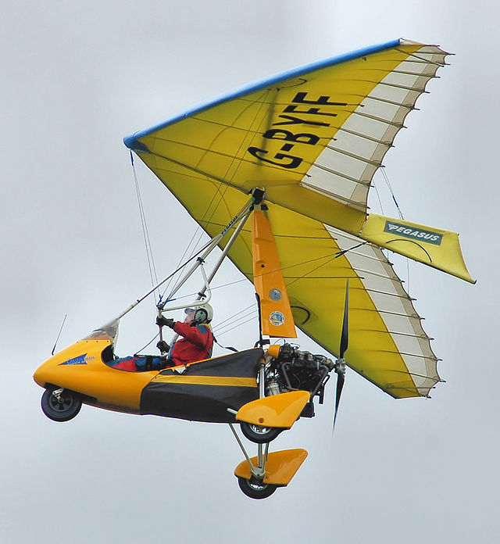
Warm Up
5 minute research
What is flight?
1 other aviation fact
5 minutes: Groups of 3 breakout rooms; Introduce yourself, definition + fact
5 minutes: Come back to main room & every team shares their definition + fact
Notes:
Jasmine

Slide 4
Warm-Up
Flight Definitions:
Act of passing through the air with the use of wings or an object designed to control an object
Process by which an object does not touch any planetary surfaces -- either through an atmosphere without touching any surface or hitting outer space
Action or process of flying through the air
Aerospace facts:
Notes:
Jasmine says words Alex writes it down

Slide 5
Basics of Aviation
How do planes fly?

Slide 6
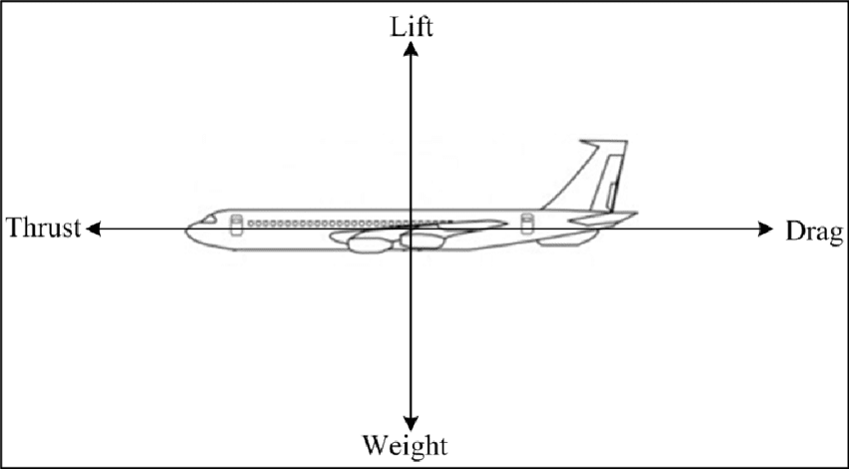
If the thrust is greater than drag, the plane accelerates
If lift is greater than the weight, the plane goes up
Notes:
alexalex

Slide 7
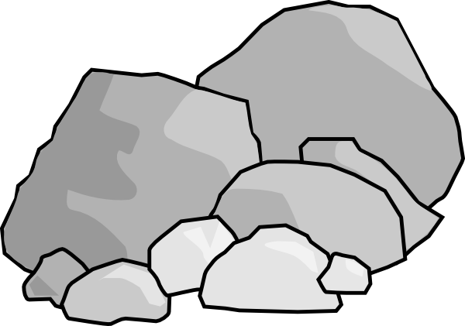
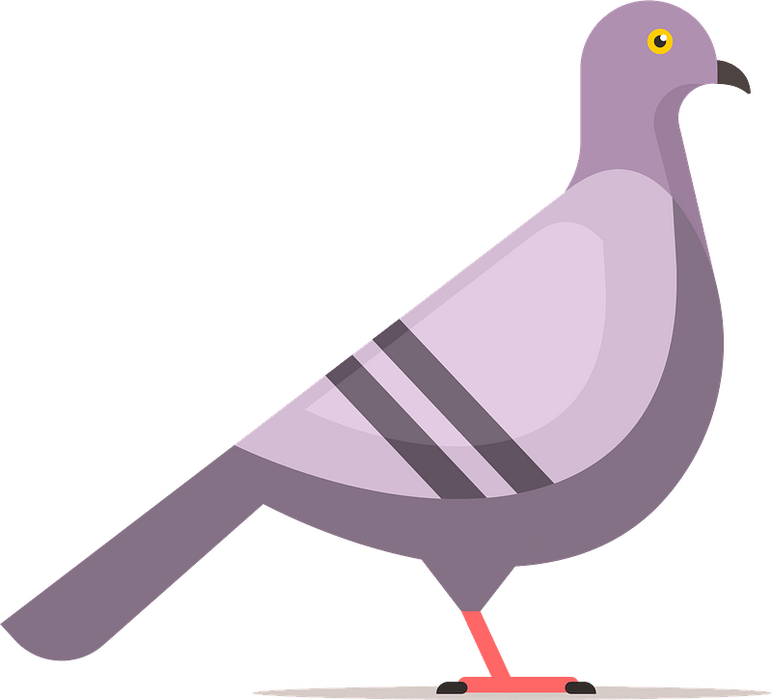


Our Definition of Flight:
Doesn’t Fly
Flies
When an object is able to control their lift and thrust in order to be in the air
Notes:
Jasminejasmine

Slide 8
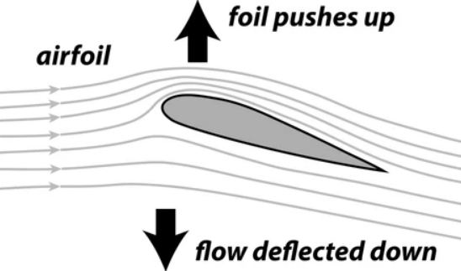
Lift
Air moving across the wings creates lift (upwards force)
The air moves faster across the top than the bottom of the wing
Pressure above > pressure below, plane goes up
Air hitting the bottom of the wing pushes the wing up
Notes:
maya

Slide 9
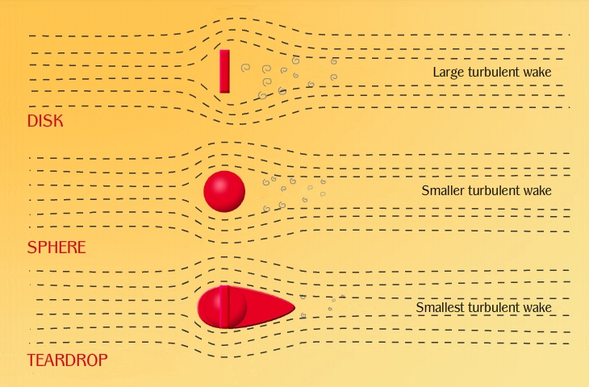
Drag
The force countering the movement of an object in a fluid (air, water)
Increases with angle of attack because of wind resistance
Streamlining:
Notes:
jasmine
The force countering the movement of an object in a fluid (air, water)
Increases with angle of attack because of wind resistance to flat underbelly of aerofoil
Streamlining is how big of a wake is generated by objects when faced directly into the medium of movement.
Is why all sports cars are low and have little flat surfaces in the front

Slide 10
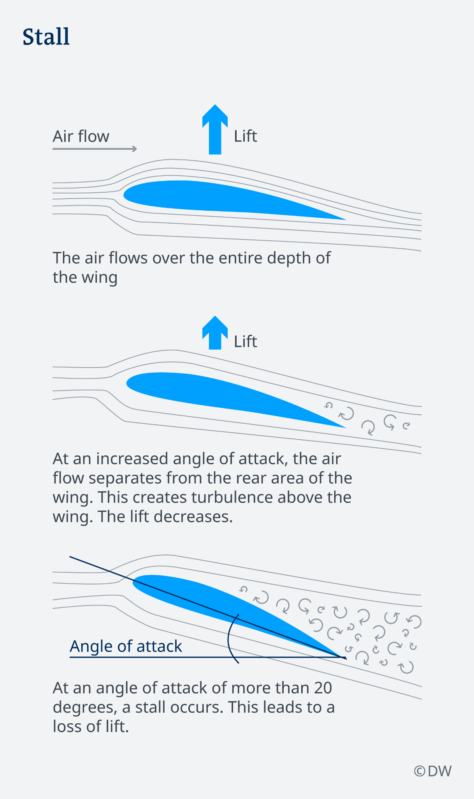
Stall
Plane falls out of the air
Happens because the plane lost the minimal amount of lift to keep it suspended in air.
Speed is too slow
Angle of attack is too high - producing more drag than lift
Notes:
alex

Slide 11
Question!
If drag is greater than thrust which of the following will happen?
The plane will speed up
The plane will rise
The plane will slow down
The plane will do a loop-de-loop
Notes:
maya

Slide 12
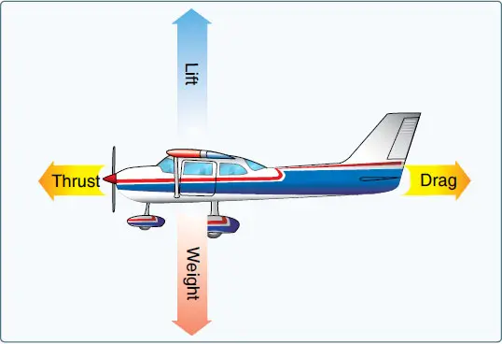
Answer:
c - The plane will slow down
Notes:
jasmine

Slide 13
Parts of the Plane

Slide 14
3 minutes- try to define Fuselage
At the end: can someone share out?
Notes:
alex

Slide 15
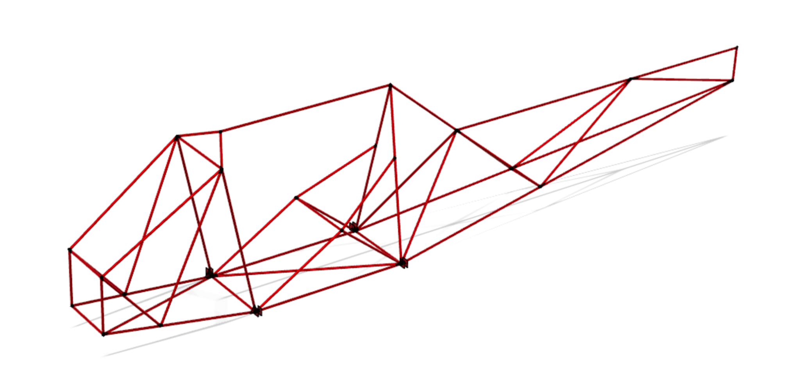
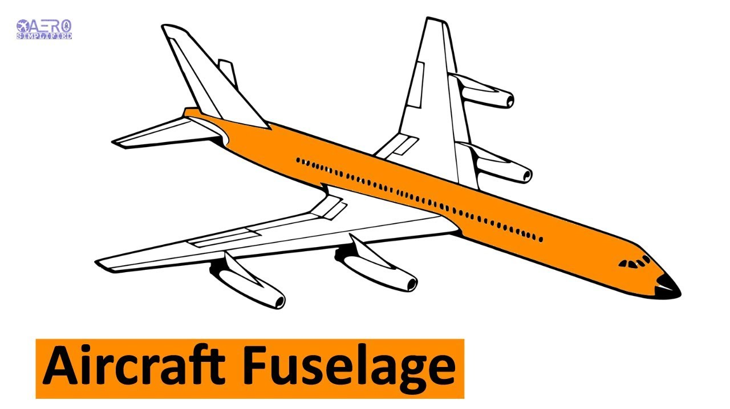
Fuselage
The body of the plane. The thing that connects everything else together.
Our fuselage - tour on Fusion
Big jet Fuselage
Notes:
alex

Slide 16
2 minutes- How do landing gear help the plane?
At the end: can someone share out?
Notes:
maya

Slide 17
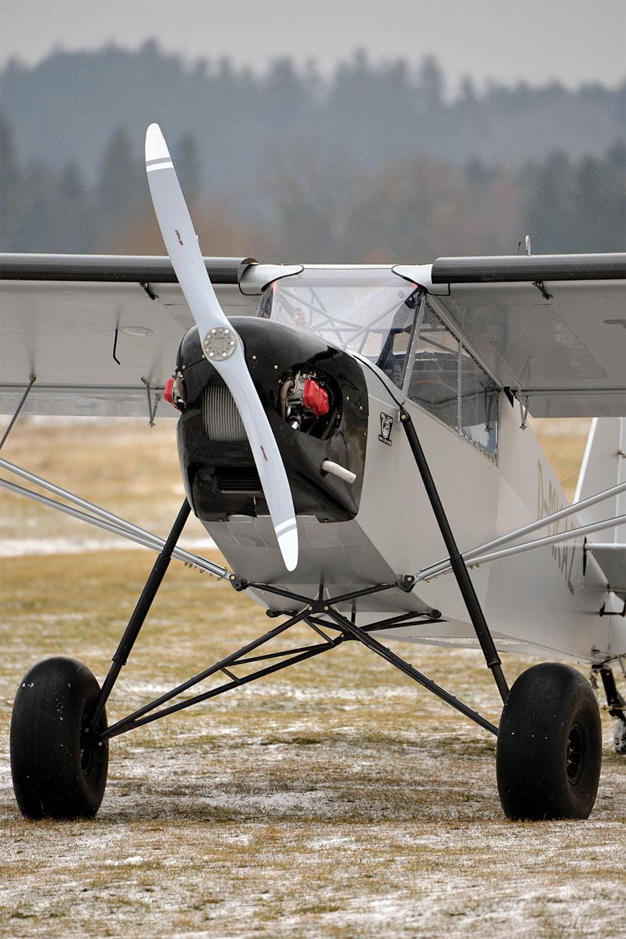
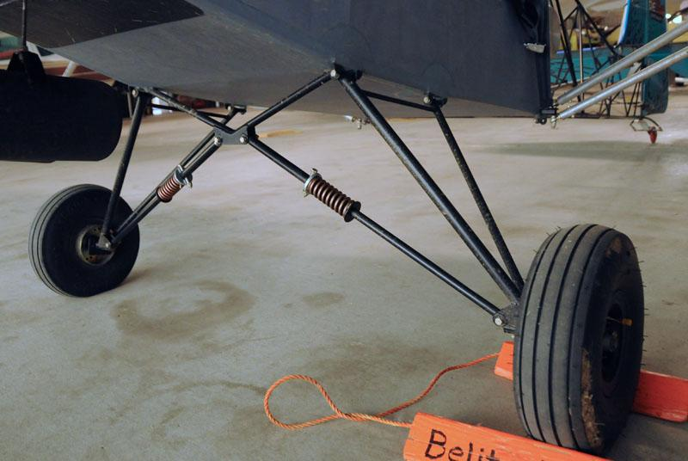
Landing Gear
Used for takeoff and landing
Helps to lessen the impact when a plane lands
Notes:
maya

Slide 18
2 minutes- What is one part of a Wing?
At the end: can 3 people share out?
3 parts of the wing:
Flaps
Aileron → extend out from the middle and go till the end of the wing → make the plane roll
Spars
Notes:
jasmine

Slide 19
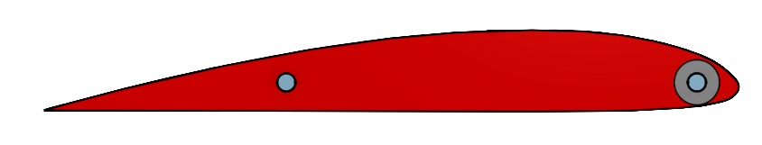
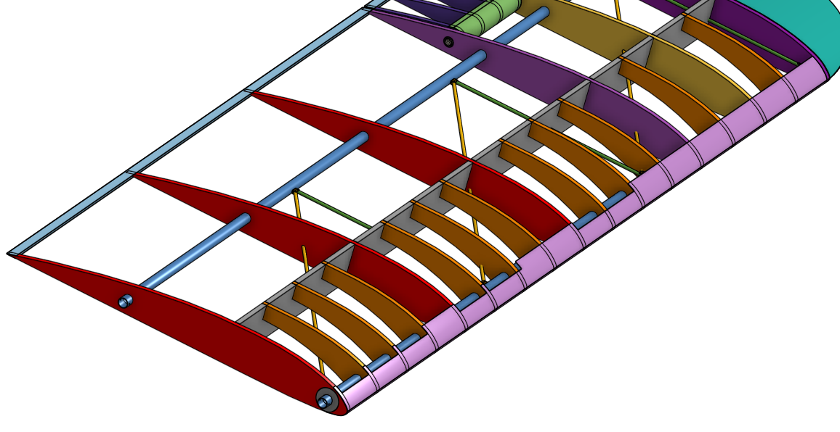
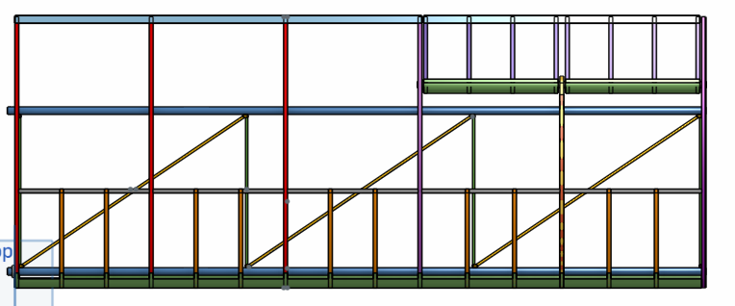
Wings - Link to onshape
We have a different presentation on the wings soon!
Notes:
jasmine

Slide 20
Other Parts

Slide 21
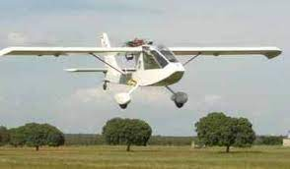
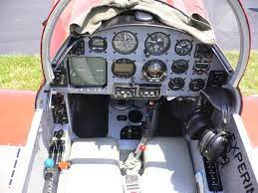
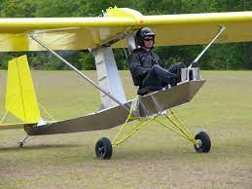
Cockpit
Where the pilot sits!
Contains controls and information from sensors
This information is stuff like engine temperature, speed, altitude, fuel or battery left, and a compass
Can control speed, point, and roll, among other things
Notes:
alex

Slide 22
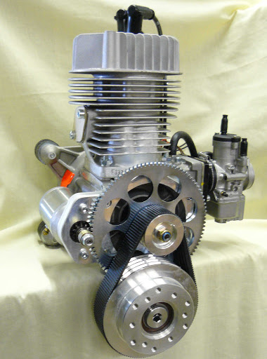
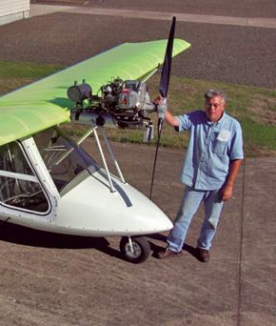
Engine
Provides power to the propeller, which helps to move the plane forward
Gas or battery powered (electric)
Can be mounted in the front or back of the plane
Notes:
maya

Slide 23
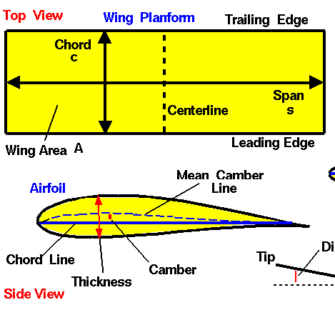
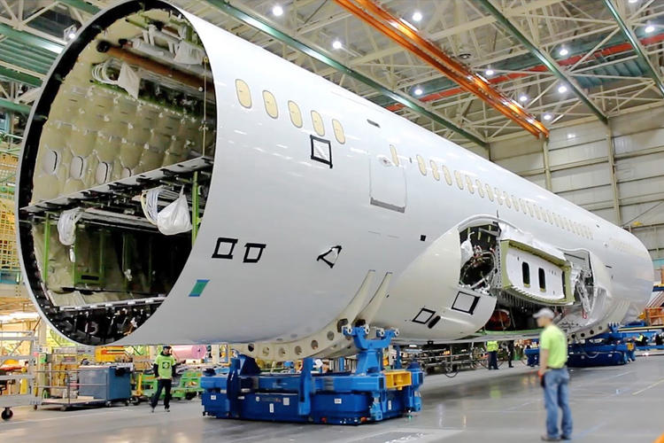
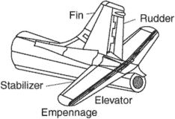
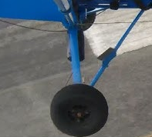
5 minutes- try to define these terms:
Empennage
Aspect Ratio
Match them to the pictures on the right
Have your responses ready in the chat, we’ll tell you when the press enter
2 of them are not on the list! Can you name them?
a)
c)
b)
d)
Notes:
jasmine

Slide 24
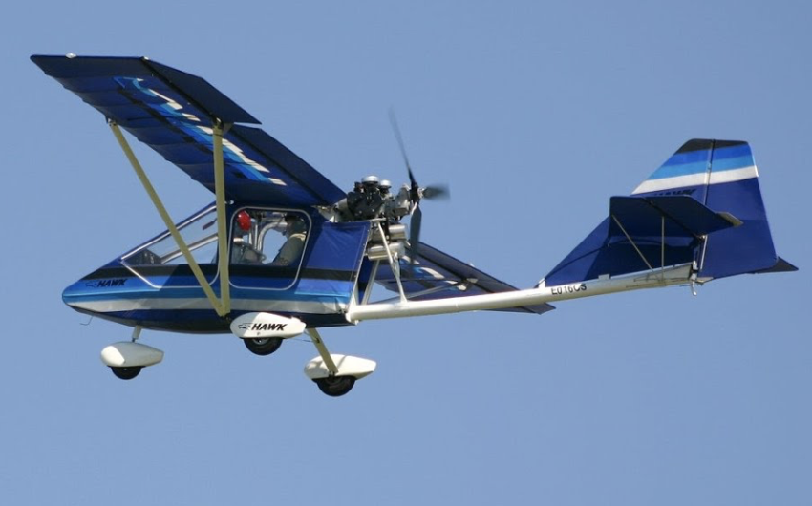
Work in breakout rooms
Can you label this plane?
Instructions:
Go to the slide number of your breakout room
Fill in the text boxes with what you think the name of the part is
Notes:
alex

Slide 25
Give this paper plane a shot!
https://www.grc.nasa.gov/www/k-12/WindTunnel/Activities/foldairplane.html
Label the parts of it with a paperclip
Notes:
jasmine

Slide 26
Notes
Introduce other ultralights (legal eagle, ehawk, etc)
Paper plane interactive thingys

Slide 27
Welcome!
Icebreaker thingy here
Icebreaker ideas: for general lol
Guess who (not for first day tho)
Basically you get people to write down answers to a bunch of random questions and then people have to try to guess who it is
2 truths and a lie
riddles/puzzles/warm-up Qs
Watching a funny video?
Find the worst virtual background + zoom filter combo
Scribbl.io (if only we could make this FCA-themed)
FCA pictionary?
Trivia/kahoot (using this in the slides a lot tho)

